Slide 1

Distributional Impacts of Energy and Climate Policies in Germany and the EU
Montenegro
Roland

Slide 2
Agenda
Introduction
Environmental tax reform (ETR)
Methodological implementations
Household consumption
Elasticity of substitution between energy and housing services
Scenarios
Limitations and Results

Slide 3
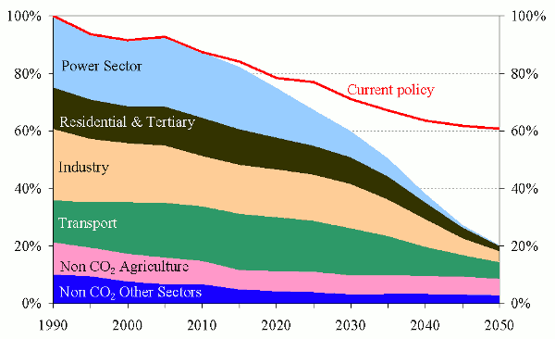
Introduction
European Emission target
The burden has to be distributed among all the sectors in the economy.
Source: EC
https://ec.europa.eu/clima/policies/strategies/2050_en

Slide 4
Introduction
Distributional impacts
What are they?
Distributional impacts refer to the case when different household groups or individuals are affected by a policy to a different degree.
Commonly associated with inequality
Differences in environmental burden
Distribution of income
Distribution of welfare
Access to energy (and carbon)

Slide 5



Introduction
Distributional impacts – Growing attention
2030 Agenda for Sustainable Development by the United Nations
17 Social Development Goals (SDGs)
3 of which are directly connected to either energy or inequality
https://sdgs.un.org/goals

Slide 6

Introduction
Distributional impacts – Growing attention
Yellow vest movement
Originally, the yellow vest protesters were people from rural areas who have to drive long distances as part of their daily life.
Their initial demand was to repeal the green tax on diesel. Now, others want the current minimum wage (about $1,350 per month after taxes) to be raised.
https://www.npr.org/2018/12/03/672862353/who-are-frances-yellow-vest-protesters-and-what-do-they-want?t=1607006502419

Slide 7
Introduction
Objective
In light of the side effects of energy and climate policies in terms of income distribution and burden sharing, my main objectives are:
Development of a technically based method to represent distributional impacts in the household sector.
Analyze policy alternatives that aim on mitigating negative distributional effects of energy and climate policies

Slide 8
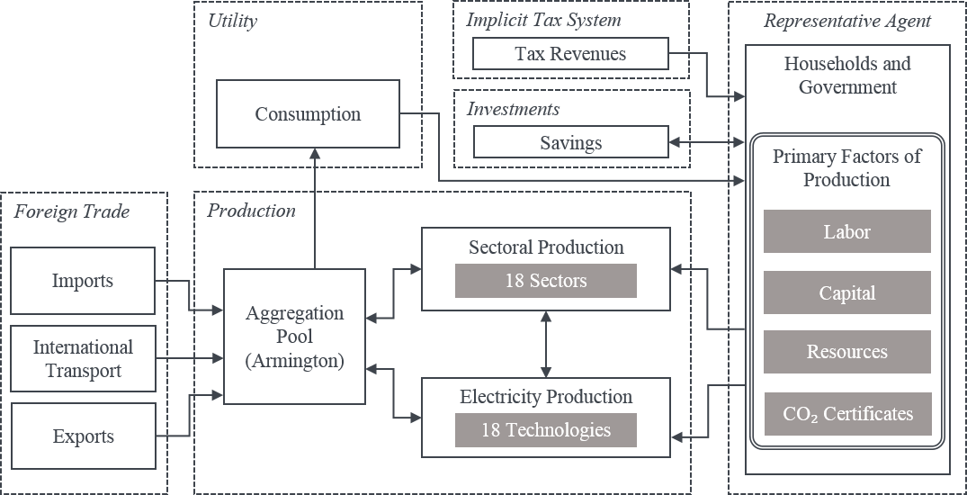
Methodology
NEWAGE
NEWAGE was not able to display distributional impacts on a household level because it represented the households as one homogenous actor.
In order to display them, the first step was to disaggregate the representative agent into income quintiles and the government.

Slide 9
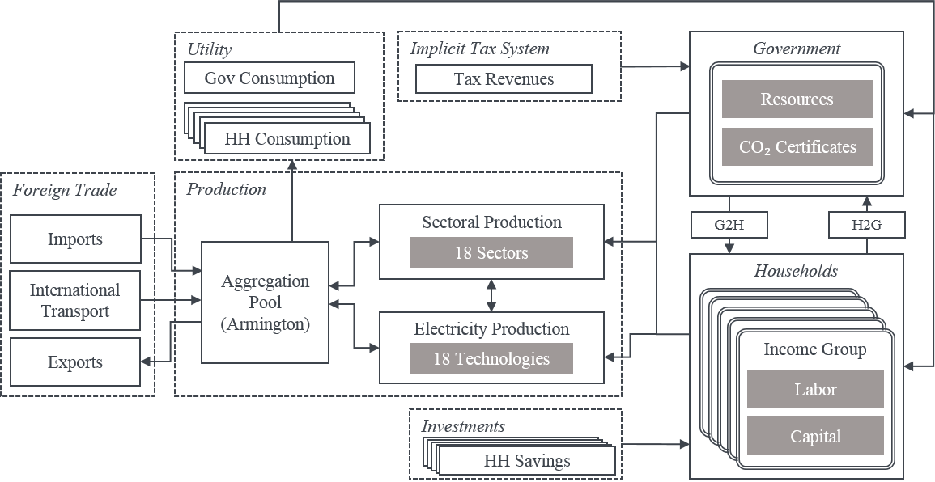
Methodology
NEWAGE – Multiple households
Specific consumption function for each income group
Explicit modeling of tax transfer
Specific labor and capital endowment
Specific saving propensity for each income group

Slide 10
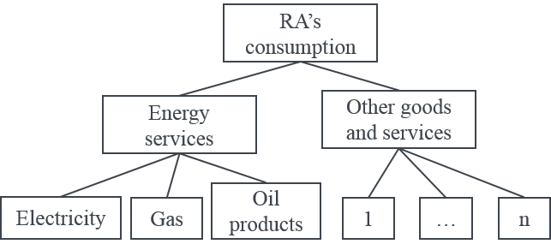
Methodology
NEWAGE – Households energy consumption
The original nesting for household consumption grouped energy services separated from all other sectors.
This representation didn’t allow for substitution between energy goods and housing improvements, for example.

Slide 11
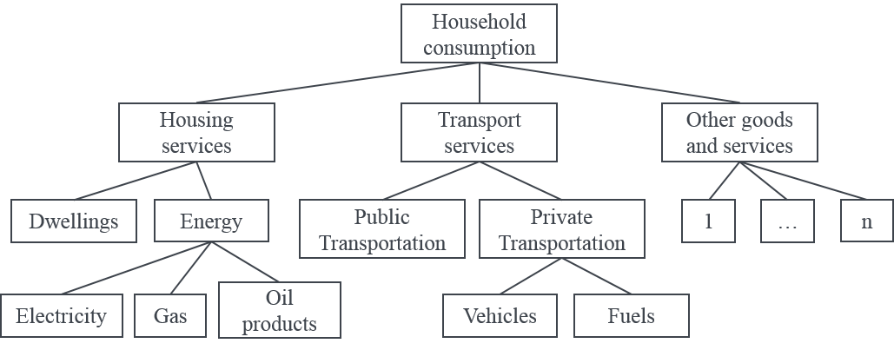
Methodology
NEWAGE – Households energy consumption
The new representation, based on Bye et al. 2017* , allows for a better representation of the consumption of energy goods and direct substitutes.
Energy for heating can be substituted by consumption of dwelling services, which can represent either improving thermal isolation or the payment of higher rent for a more efficient housing.
* https://doi.org/10.1016/j.energy.2017.10.103

Slide 12
Methodology
Households energy consumption – Elasticity of substitution
Housing services
?
Dwellings
Energy
Electricity
Gas
Oil products

Slide 13
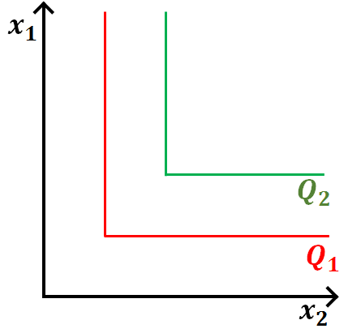
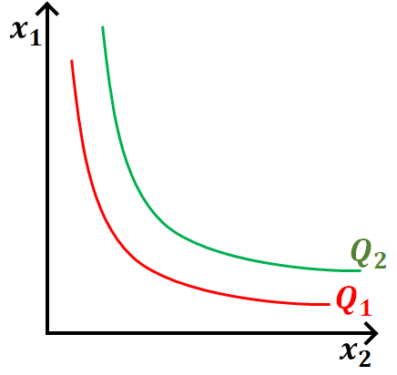
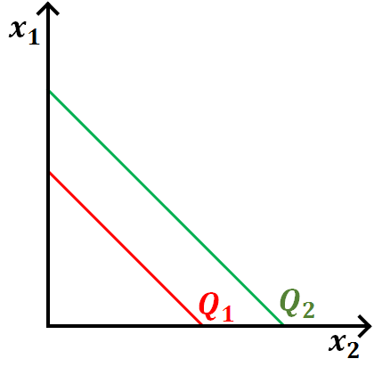


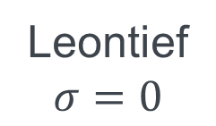
Methodology
Households energy consumption – Elasticity of substitution
Leontief
$$σ=0$$
Cobb-Douglas
$$σ=1$$
Perfect substitution
$$σ=∞$$
Where “Q” represents the level of production

Slide 14
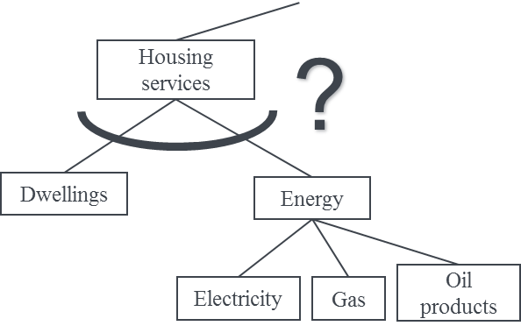
Methodology
Households energy consumption – Elasticity of substitution
Aggregate investment options for thermal isolation

Slide 15
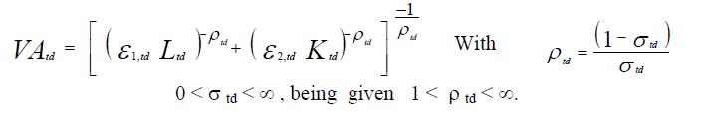
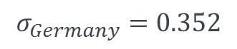
Methodology
Households energy consumption – Elasticity of substitution
Fit
$$σ_{Germany}=0.352$$
Repeat the process for each of the 8 remaining EU regions

Slide 16


Environmental Tax Reform
Double dividend hypothesis
Concept
It refers to the notion that environmental taxes can both reduce pollution (the first dividend) and reduce the overall economic costs associated with the tax system by using the revenue generated to displace other more distortionary taxes that slow economic growth at the same time (the second dividend).
1. Lower emissions
2. Better economic output
https://www.eea.europa.eu/help/glossary/eea-glossary/double-dividend#:~:text=with%20javascript%20off.-,Term,time%20(the%20second%20dividend).

Slide 17
Environmental Tax Reform
What researchers say?
https://www.eea.europa.eu/help/glossary/eea-glossary/double-dividend#:~:text=with%20javascript%20off.-,Term,time%20(the%20second%20dividend).

Slide 18
Scenarios
Reduction scenario

Slide 19
Scenarios
Revenue recycling scenarios
No revenue recycling – Status Quo
Per capita redistribution
Labor tax
Value added tax (VAT)

Slide 20
Recap from last year
Motivation – Challenge

Slide 21
Recap from last year
Motivation – Summary
Assessment of climate polices is measured not only on how much climate impact they avoid, but also on their impact in the whole economy
What are the costs to the households?
How the costs of climate policies vary between different households?
And the what are costs to production sectors?

Slide 22
Bibliography
van Ruijven, Bas J. & O’Neill, Brian C. & Chateau, Jean, 2015. "Methods for including income distribution in global CGE models for long-term climate change research," Energy Economics, Elsevier, vol. 51(C), pages 530-543. https://ideas.repec.org/a/eee/eneeco/v51y2015icp530-543.html
Shoven, J. & Whalley, J., 1992. “Applying General Equilibrium” Cambridge University Press.
A. Bouet, V. Berisha-Krasniqui, C. Estrade und D. Laborde, „Households heterogeneity in a global CGE model: an illustration with the MIRAGE-HH (MIRAGE-HouseHolds) model,“ Larefi, Université Bordeaux 4, Bordeaux, 2013.
W. Cai, Y. Mu, C. Wang und J. Chen, „Distributional employment impacts of renewable and new energy – A case study of china,“ Renewable and Sustainable Energy Reviews, Bd. 39, pp. 1155-1163, 2014.
S. Rausch und M. Mowers, „Distributional and efficiency impacts of clean and renewable energy standards for electricity,“ Resource and Energy Economics, Bd. 36, Nr. 2, p. 556–585, 2014.
Arrow, K. & Debreu, G., 1954. “Existence of Equilibrium for a Competitive Economy” Econometrica, The Econometric Society.
Kelly, D., 2009 “Subsidies to industry and the environment” National Bureau of Economic Research

Slide 23

IER
Roland Cunha Montenegro
roland.montenegro@ier.uni-stuttgart.de
87833
87873
Institut für Energiewirtschaft und Rationelle Energieanwendung (IER)
Heßbrühlstraße 49a, 70565 Stuttgart

Slide 24
Questions?

